Slide 1
COURSE TITLE: Data Communications and Networks
UNIT -1

Slide 2
UNIT 1:

Slide 3
Introduction to networks
What is a network?
A network is two or more computers (or other electronic devices) that are connected together, usually by cables or Wi-Fi.
Some computer networks will have a server. A server is a powerful computer that often acts as a central hub for services in a network, eg emails, internet access and file storage. Each computer connected to a server is called a client.
A computer that is not connected to a network is called a standalone computer.

Slide 4
Introduction to networks
Networking is critical if you want to use your computer to communicate. Without it you couldn’t send an email, a text or an instant message.
We use a huge network on a daily basis and this is called the internet. Billions of people use the internet to share data, news and resources, amongst many other things.

Slide 5
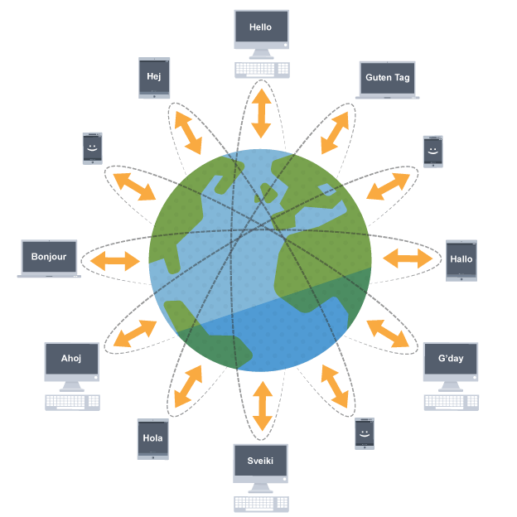
Introduction to networks

Slide 6
Introduction to networks
What is Computer Networking?
A computer network is a system that connects numerous independent computers in order to share information (data) and resources. The integration of computers and other different devices allows users to communicate more easily.
A computer network is a collection of two or more computer systems that are linked together. A network connection can be established using either cable or wireless media. Hardware and software are used to connect computers and tools in any network.
A computer network consists of various kinds of nodes. Servers, networking hardware, personal computers, and other specialized or general-purpose hosts can all be nodes in a computer network. Hostnames and network addresses are used to identify them.

Slide 7
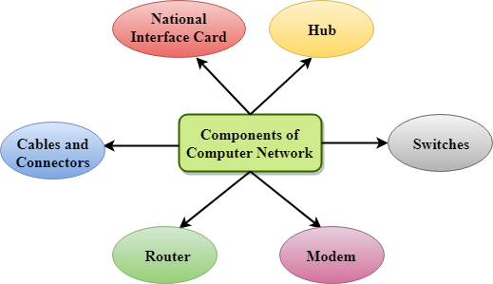
Introduction to networks
Components Of Computer Network:

Slide 8
Theoretical Model for Communication
What is the OSI Model?
The open systems interconnection (OSI) model is a conceptual model created by the International Organization for Standardization which enables diverse communication systems to communicate using standard protocols. In plain English, the OSI provides a standard for different computer systems to be able to communicate with each other.
The OSI Model can be seen as a universal language for computer networking. It is based on the concept of splitting up a communication system into seven abstract layers, each one stacked upon the last.

Slide 9
Theoretical Model for Communication
What is the OSI Model?
The open systems interconnection (OSI) model is a conceptual model created by the International Organization for Standardization which enables diverse communication systems to communicate using standard protocols. In plain English, the OSI provides a standard for different computer systems to be able to communicate with each other.
The OSI Model can be seen as a universal language for computer networking. It is based on the concept of splitting up a communication system into seven abstract layers, each one stacked upon the last.

Slide 10
Theoretical Model for Communication
Layers of OSI Model
There are the seven OSI layers. Each layer has different functions. A list of seven layers are given below:
Physical Layer
Data-Link Layer
Network Layer
Transport Layer
Session Layer
Presentation Layer
Application Layer

Slide 11
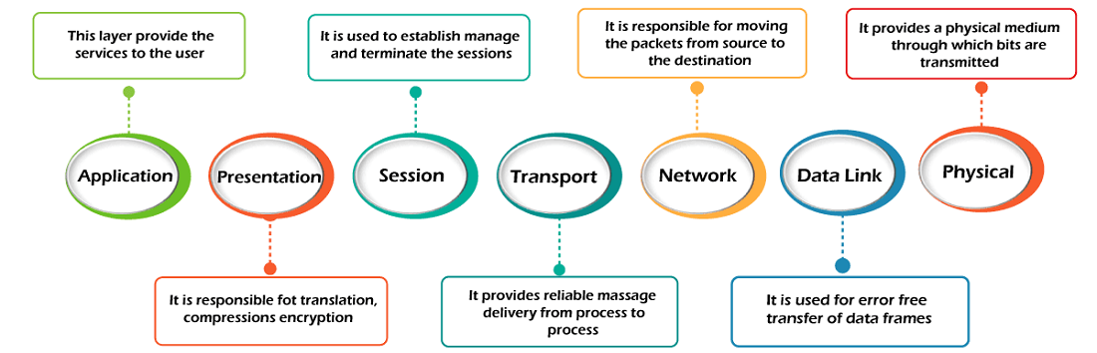
Theoretical Model for Communication

Slide 12
Analog Vs Digital
Analog and digital signals are the types of signals carrying information. The major difference between both signals is that the analog signals have continuous electrical signals, while digital signals have non-continuous electrical signals.
The difference between analog and digital signal can be observed with the examples of different types of waves.

Slide 13
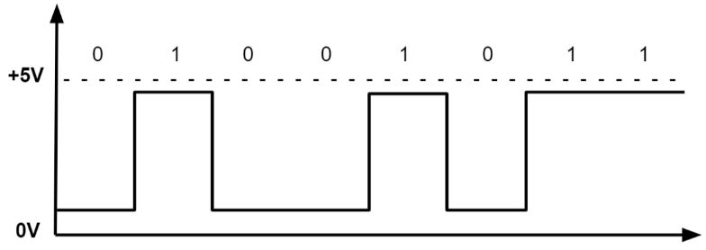
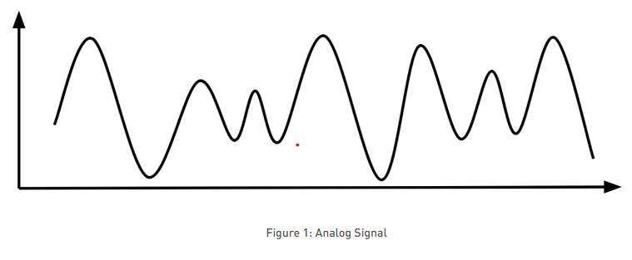
Analog Vs Digital
ANALOG
DIGITAL

Slide 14
Analog Vs Digital
What Are Analog Signals?
Analog signals were used in many systems to produce signals to carry information. These signals are continuous in both values and time. The use of analog signals has declined with the arrival of digital signals. In short, to understand analog signals – all signals that are natural or come naturally are analog signals.
What Are Digital Signals?
Unlike analog signals, digital signals are not continuous, but signals are discrete in value and time. These signals are represented by binary numbers and consist of different voltage values.

Slide 15
Analog Vs Digital
What Are Analog Signals?
Analog signals were used in many systems to produce signals to carry information. These signals are continuous in both values and time. The use of analog signals has declined with the arrival of digital signals. In short, to understand analog signals – all signals that are natural or come naturally are analog signals.
What Are Digital Signals?
Unlike analog signals, digital signals are not continuous, but signals are discrete in value and time. These signals are represented by binary numbers and consist of different voltage values.

Slide 16
Analog Vs Digital
Difference between Analog and Digital Signal
Analog Signals | Digital Signals
Continuous signals | Discrete signals
Represented by sine waves | Represented by square waves
Human voice, natural sound, analog electronic devices are a few examples | Computers, optical drives, and other electronic devices
Continuous range of values | Discontinuous values
Records sound waves as they are | Converts into a binary waveform
Only used in analog devices | Suited for digital electronics like computers, mobiles and more

Slide 17
Bandwidth
Bandwidth, or precisely network bandwidth, is the maximum rate at which data transfer occurs across any particular path of the network.
Bandwidth is basically a measure of the amount of data that can be sent and received at any instance of time.
That simply means that higher is the bandwidth of a network, larger is the amount of data network can be sending to and from across its path.
Be careful not to confuse bandwidth with closely related terms such as the data rate and the throughput. Bandwidth is something that deals with the measurement of capacity and not the speed of data transfer.

Slide 18
Bandwidth
Units of Measurement :
Bandwidth is usually measured in bits transferred per second through a path or link. The common units of bandwidth we come across are as follows.
bps (Bits per second)
Mbps (Megabits per second)
Gbps (Gigabits per second)
Example –
Here, a bandwidth of 10 bps for a channel, is just another way of saying that a maximum of 10 bits can be transferred using that link for any given time. It has no relation with the transfer speed of the channel.

Slide 19
Bandwidth
Bandwidth is often mistaken for internet speed when it's actually the volume of information that can be sent over a connection in a measured amount of time – calculated in megabits per second (Mbps).
What's the difference?
Some internet terms are so similar that they’re often confused with each other. We're here to help set the record straight.
Bandwidth vs speed
Bandwidth is how much information you receive every second, while speed is how fast that information is received or downloaded. Let's compare it to filling a bathtub. If the bathtub faucet has a wide opening, more water can flow at a faster rate than if the pipe was narrower. Think of the water as the bandwidth and the rate at which the water flows as the speed.

Slide 20
Bandwidth
Bandwidth vs throughput
Throughput is how much information actually gets delivered in a certain amount of time. So if bandwidth is the max amount of data, throughput is how much of that data makes it to its destination – taking latency, network speed, packet loss and other factors into account.

Slide 21
Noise
Noise is unwanted electrical or electromagnetic energy that degrades the quality of signals and data. Noise occurs in digital and analog systems, and can affect files and communications of all types, including text, programs, images, and audio.
While transmission we get errors, the reason of transmission impairment is noise. In networking, noise is an unwanted signal produced in the transmission medium.

Slide 22
Noise
With electronics, noise is any disturbance that interferes with data transmission or communication and corrupts the quality of the signal. Below are examples of where noise can be encountered in data transmission and its common causes.
Audio, image, or video signal noise.
Electrical signal noise.
Wireless signal noise.

Slide 23
Noise
With electronics, noise is any disturbance that interferes with data transmission or communication and corrupts the quality of the signal. Below are examples of where noise can be encountered in data transmission and its common causes.
Audio, image, or video signal noise.
Electrical signal noise.
Wireless signal noise.

Slide 24
Noise
Audio, image, or video signal noise
Degradation in audio and video signals can reduce the overall quality of audio, images, and videos. In audio, noise manifests as a hiss. In images or videos, noise refers to random multicolored or varied-brightness pixels that overlay an image. Noise is often caused by one or more of the following reasons.
Loose connection; verify all your connections are attached correctly.
If you have more than one wire used for audio or video, or other nearby cords or cables, make sure they are separated to prevent crosstalk. Cables with poor shielding can cause noise in close wiring.
Bad cables; try replacing cables.
When taking a picture, grainy or noisy images can be caused by a high ISO setting, low light conditions, camera sensors, analog conversion, or digital processing techniques.

Slide 25
Noise
Electrical signal noise
Electrical or power noise can create disruptions in power, causing devices to temporarily not work or permanently fail.
To help protect against power spikes, surges, and other line noises, connect all your electronic equipment to a surge protector.
To protect your devices from failing in the event of a power outage, undervoltage, or brownout, connect your equipment to a UPS (uninterruptible power supply).

Slide 26
Noise
Wireless signal noise
Wireless noise or poor connection is often caused by one or more of the reasons listed below.
Receiver blocked - If the antenna is not set up properly or a wireless receiver is blocked, it can cause noise.
Out of range - As you get further away from the receiver, your signal strength decreases and can cause noise or lost connection.
Other wireless interference - If other wireless devices are around your location, their signals can disrupt your connection.
Lower power - If the batteries are failing on the wireless device, it can degrade the signal being transmitted or received.

Slide 27
Noise
What is the signal-to-noise ratio?
In analog and digital communications, a signal-to-noise ratio, often written S/N or SNR, is a measure of the strength of the desired signal relative to background noise (undesired signal). S/N can be determined by using a fixed formula that compares the two levels and returns the ratio, which shows whether the noise level is impacting the desired signal.
The ratio is typically expressed as a single numeric value in decibels (dB). The ratio can be zero, a positive number or a negative number. A signal-to-noise ratio over 0 dB indicates that the signal level is greater than the noise level. The higher the ratio, the better the signal quality.

Slide 28
Noise
For example, a Wi-Fi signal with S/N of 40 dB will deliver better network services than a signal with S/N of 20 dB. If a Wi-Fi signal's S/N is too low, network performance can be impacted because it becomes more difficult for devices to distinguish the desired signal from the noise. This can result in dropped packets and data retransmissions, leading to lower throughput and higher latency.
Noise includes any unwanted disturbance that degrades the quality of the desired signal. It can include thermal, quantum, electronic, impulse or intermodulation noise, as well as other forms of noise. Environmental factors, such as temperature and humidity, can also affect noise levels.

Slide 29
Noise
If the noise is significant enough in comparison to the desired signal -- that is, S/N is low -- it can disrupt a wide range of data transfers, including text files, graphics, telemetry, applications, and audio and video streams.

Slide 30
Noise
How do you calculate the signal-to-noise ratio?
The signal-to-noise ratio is typically measured in decibels and can be calculated by using a base 10 logarithm. The exact formula depends on how the signal and noise levels are measured, though.
For example, if they're measured in microvolts, the following formula can be used:
S/N = 20 log10(Ps/Pn)
Ps is the signal in microvolts, and Pn is the noise in microvolts.
However, if the signal and noise are measured in watts, the formula is slightly different:
S/N = 10 log10(Ps/Pn)

Slide 31
Noise
When Ps is greater than Pn, S/N will be positive. Ideally, Ps should be much greater than Pn to minimize noise interference. As an example, suppose that Ps equals 10 microvolts and Pn equals 1 microvolt. Because 10 divided by 1 equals 10, the following formula can be used to calculate S/N:
S/N = 20 log10(10) = 20 dB
A ratio of 20 dB means that the signal is clearly readable. If the signal is much weaker but still above the noise level -- say, 1.3 microvolts -- S/N is much lower, in this case, only 2.28 dB:
S/N = 20 log10(1.3) = 2.28 dB

Slide 32
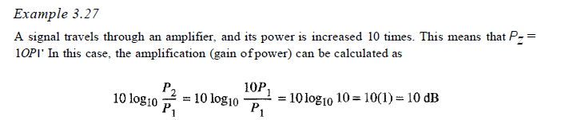
Noise

Slide 33
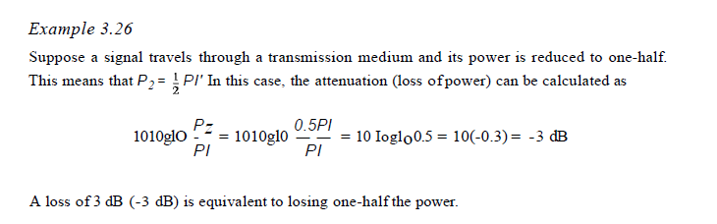
Noise

Slide 34
Channel Capacity
The maximum quantity of traffic or signal that may pass over a particular infrastructure channel is channel capacity. It can be used to assess the capacity of a channel or conduit in computer science, electrical engineering, and other areas.
By capacity of a channel, it means the capacity of the transmission medium (wire or link). Capacity is the number of bits the transmission medium can hold.

Slide 35
Channel Capacity
The capacity of the channel depends on two things:
Bandwidth
Propagation delay
Capacity = bandwidth * propagation delay
(in case of half duplex)
Capacity =2* bandwidth * propagation delay
(in case of full duplex)

Slide 36
Channel Capacity
Types of Communication Channel
There are three types of communication channels in computer networking −
Simplex channel − Signals can only be sent in one way using a simple communication connection. As a result, the channel's complete bandwidth can be used during transmission.
2. Half-duplex channel − A half-duplex communication channel can send signals in both directions simultaneously, but only in one. It can be thought of as a simplex communication channel with a switchable transmission direction.

Slide 37
Channel Capacity
3. Full-duplex channel − A full-duplex communication link can simultaneously send signals in both directions. Communication efficiency is considerably improved by using full-duplex communication channels.

Slide 38

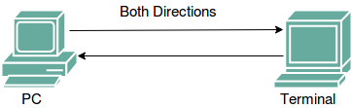
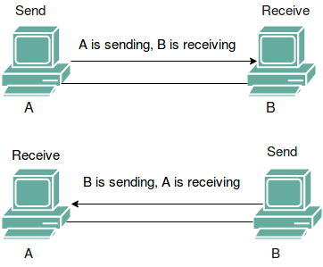
Channel Capacity
Simplex
Full Duplex
Half Duplex

Slide 39
Channel Capacity
Noiseless Channel: Nyquist Bit Rate –
For a noiseless channel, the Nyquist bit rate formula defines the theoretical maximum bit rate
Nyquist proved that if an arbitrary signal has been run through a low-pass filter of bandwidth, the filtered signal can be completely reconstructed by making only 2*Bandwidth (exact) samples per second. Sampling the line faster than 2*Bandwidth times per second is pointless because the higher-frequency components that such sampling could recover have already been filtered out. If the signal consists of L discrete levels, Nyquist’s theorem states:

Slide 40
Channel Capacity
BitRate = 2 * Bandwidth * log2(L) bits/sec
In the above equation, bandwidth is the bandwidth of the channel, L is the number of signal levels used to represent data, and BitRate is the bit rate in bits per second.
Bandwidth is a fixed quantity, so it cannot be changed. Hence, the data rate is directly proportional to the number of signal levels.

Slide 41
Channel Capacity
Examples:
Input1 : Consider a noiseless channel with a bandwidth of 3000 Hz transmitting a signal with two signal levels. What can be the maximum bit rate?
Output1 : BitRate = 2 * 3000 * log2(2) = 6000bps
Input2 : We need to send 265 kbps over a noiseless channel with a bandwidth of 20 kHz. How many signal levels do we need?
Output2 : 265000 = 2 * 20000 * log2(L)
log2(L) = 6.625
L = 26.625 = 98.7 levels

Slide 42
Channel Capacity
2. Noisy Channel : Shannon Capacity –
In reality, we cannot have a noiseless channel; the channel is always noisy. Shannon capacity is used, to determine the theoretical highest data rate for a noisy channel:
Capacity = bandwidth * log2(1 + SNR) bits/sec
In the above equation, bandwidth is the bandwidth of the channel, SNR is the signal-to-noise ratio, and capacity is the capacity of the channel in bits per second.
Bandwidth is a fixed quantity, so it cannot be changed. Hence, the channel capacity is directly proportional to the power of the signal, as SNR = (Power of signal) / (power of noise).
The signal-to-noise ratio (S/N) is usually expressed in decibels (dB) given by the formula:

Slide 43
Channel Capacity
10 * log10(S/N)
So for example a signal-to-noise ratio of 1000 is commonly expressed as:
10 * log10(1000) = 30 dB.

Slide 44
Channel Capacity
Examples:
Input1 : A telephone line normally has a bandwidth of 3000 Hz (300 to 3300 Hz) assigned for data communication. The SNR is usually 3162. What will be the capacity for this channel?
Output1 : C = 3000 * log₂(1 + SNR) = 3000 * 11.62 = 34860 bps
Input2 : The SNR is often given in decibels. Assume that SNR(dB) is 36 and the channel bandwidth is 2 MHz. Calculate the theoretical channel capacity.
Output2 : SNR(dB) = 10 * log₁₀(SNR) SNR = 10^{(SNR(dB)/10)} SNR = 10^{3.6} = 3981
Hence, C = 2 * 10⁶ * log₂(3982) = 24 MHz

Slide 45
Data Rate
Data Rate is defined as the amount of data transmitted during a specified time period over a network.
It is the speed at which data is transferred from one device to another or between a peripheral device and the computer.
It is generally measured in Mega bits per second(Mbps) or Megabytes per second(MBps).
For example, if bandwidth is 100 Mbps but the data rate is 50 Mbps, it means maximum 100 Mb of data can be transferred but the channel is transmitting only 50 Mb of data per second.

Slide 46
Data Rate
Data Transfer Rate (DTR) can be defined as the ratio of the total amount of digital data transferred between two points in some defined period of time.
Where the two points can be two network components say two computers or data can be transferred between a thumb drive and a hard drive.
Data transfer rate is actually a measure of the speed at which network components can exchange data(send or receive).
It is measured in either bits per second or bytes per second. For practical purposes, it is measured in Megabits per second or Megabytes per second.

Slide 47
Transmission Impairments
Transmission impairment occurs when the received signal is different from the transmitted signal. As we know, a signal can be transmitted as Analog signal or it can be transmitted as a digital signal.
In Analog signals due to transmission impairment the resulting received signal gets different amplitude or the shape. In the case of digitally transmitted signals at the receiver side we get changes in bits (0's or 1's).

Slide 48
Transmission Impairments
Causes
There are various causes of transmission impairments −
Noise
Distortion
Attenuation

Slide 49
Transmission Impairments
Causes
There are various causes of transmission impairments −
Noise
Distortion
Attenuation

Slide 50
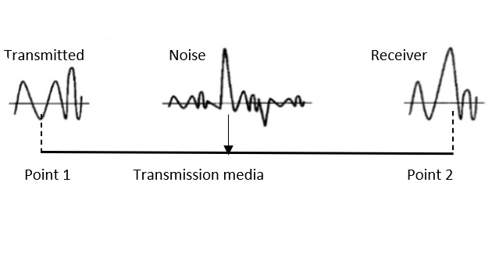
Transmission Impairments
Noise
Noise is the major factor for the transmission distortion as any unwanted signal gets added to the transmitted signal by which the resulting transmitted signal gets modified and at the receiver side it is difficult to remove the unwanted noise signal. These noises are various kinds like shot noise, impulse noise, thermal noise etc.

Slide 51
Transmission Impairments
Distortion
This kind of distortion is mainly appearing in case of composite signals in which a composite signal has various frequency components in it and each frequency component has some time constraint which makes a complete signal.
But while transmitting this composite signal, if a certain delay happens between the frequencies components, then there may be the chance that the frequency component will reach the receiver end with a different delay constraint from its original which leads to the change in shape of the signal. The delay happens due to environmental parameters or from the distance between transmitter and receiver etc.

Slide 52
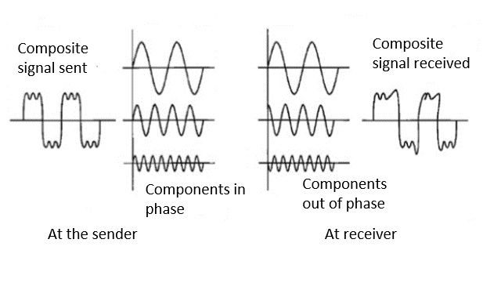
Transmission Impairments
Distortion

Slide 53

Transmission Impairments
Attenuation
Attenuation is generally decreased in signal strength, by which the received signal will be difficult to receive at the receiver end. This attenuation happens due to the majority factor by environment as environment imposes a lot of resistance and the signal strength decreases as it tries to overcome the resistance imposed.
The above picture shows that the signal loses power at its travels time.

Slide 54
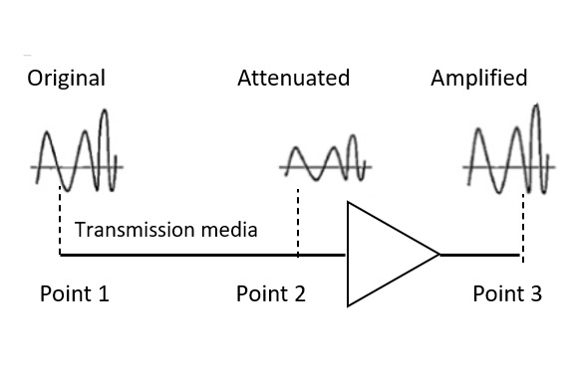
Transmission Impairments
Attenuation

Slide 55
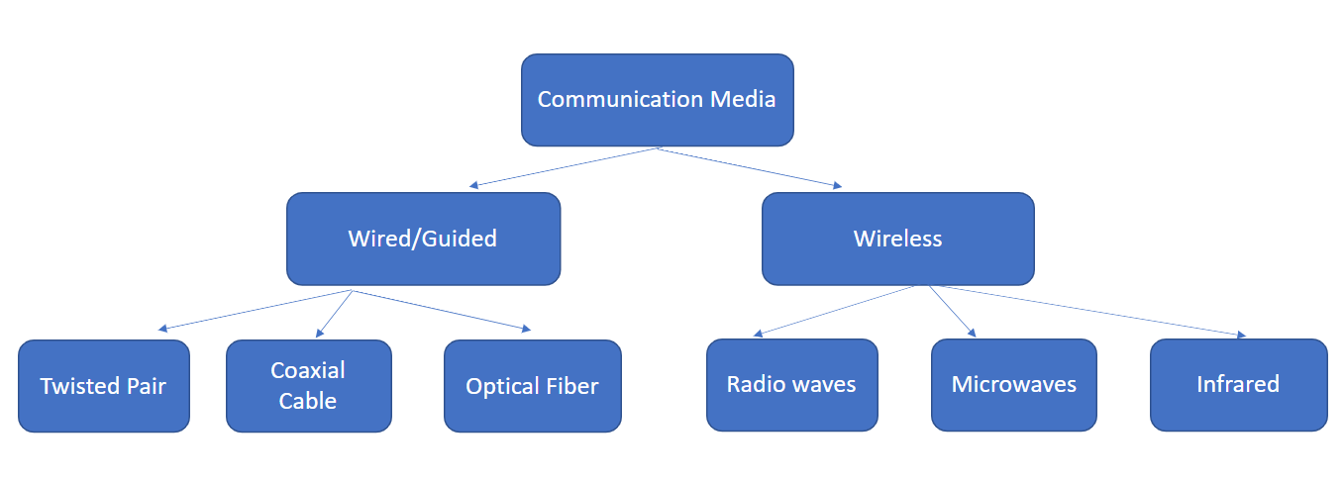
Guided Transmission Media
In data communication terminology, a transmission medium is a physical path between the transmitter and the receiver i.e. it is the channel through which data is sent from one place to another. Transmission Media is broadly classified into the following types:

Slide 56
Guided Transmission Media
Guided Media
It is also referred to as Wired or Bounded transmission media. Signals being transmitted are directed and confined in a narrow pathway by using physical links.
Features:
High Speed
Secure
Used for comparatively shorter distances

Slide 57
Guided Transmission Media
There are 3 major types of Guided Media:
(i) Twisted Pair Cable –
It consists of 2 separately insulated conductor wires wound about each other. Generally, several such pairs are bundled together in a protective sheath. They are the most widely used Transmission Media. Twisted Pair is of two types:
Unshielded Twisted Pair (UTP):
UTP consists of two insulated copper wires twisted around one another. This type of cable has the ability to block interference and does not depend on a physical shield for this purpose. It is used for telephonic applications.

Slide 58
Guided Transmission Media
Advantages:
⇢ Least expensive
⇢ Easy to install
⇢ High-speed capacity
Disadvantages:
⇢ Susceptible to external interference
⇢ Lower capacity and performance in comparison to STP
⇢ Short distance transmission due to attenuation
Applications:
Used in telephone connections and LAN networks

Slide 59
Guided Transmission Media
Shielded Twisted Pair (STP):
This type of cable consists of a special jacket (a copper braid covering or a foil shield) to block external interference. It is used in fast-data-rate Ethernet and in voice and data channels of telephone lines.
Advantages:
⇢ Better performance at a higher data rate in comparison to UTP
⇢ Eliminates crosstalk
⇢ Comparatively faster

Slide 60
Guided Transmission Media
Disadvantages:
⇢ Comparatively difficult to install and manufacture
⇢ More expensive
⇢ Bulky
Applications:
The shielded twisted pair type of cable is most frequently used in extremely cold climates, where the additional layer of outer covering makes it perfect for withstanding such temperatures or for shielding the interior components.

Slide 61

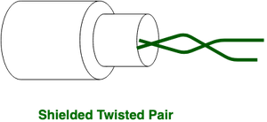
Guided Transmission Media

Slide 62
Guided Transmission Media
(ii) Coaxial Cable –
It has an outer plastic covering containing an insulation layer made of PVC or Teflon and 2 parallel conductors each having a separate insulated protection cover.
The coaxial cable transmits information in two modes: Baseband mode(dedicated cable bandwidth) and Broadband mode(cable bandwidth is split into separate ranges).
Cable TVs and analog television networks widely use Coaxial cables.

Slide 63
Guided Transmission Media
(ii) Coaxial Cable –
Advantages:
High Bandwidth
Better noise Immunity
Easy to install and expand
Inexpensive
Disadvantages:
Single cable failure can disrupt the entire network

Slide 64
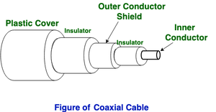
Guided Transmission Media

Slide 65
Guided Transmission Media
Applications:
Radio frequency signals are sent over coaxial wire. It can be used for cable television signal distribution, digital audio (S/PDIF), computer network connections (like Ethernet), and feedlines that connect radio transmitters and receivers to their antennas.

Slide 66
Guided Transmission Media
(iii) Optical Fiber Cable –
It uses the concept of refraction of light through a core made up of glass or plastic.
The core is surrounded by a less dense glass or plastic covering called the cladding. It is used for the transmission of large volumes of data.
The cable can be unidirectional or bidirectional. The WDM (Wavelength Division Multiplexer) supports two modes, namely unidirectional and bidirectional mode.

Slide 67
Guided Transmission Media
(iii) Optical Fiber Cable –
Advantages: Increased capacity and bandwidth Lightweight Less signal attenuation Immunity to electromagnetic interference Resistance to corrosive materials | Disadvantages: Difficult to install and maintain High cost Fragile

Slide 68
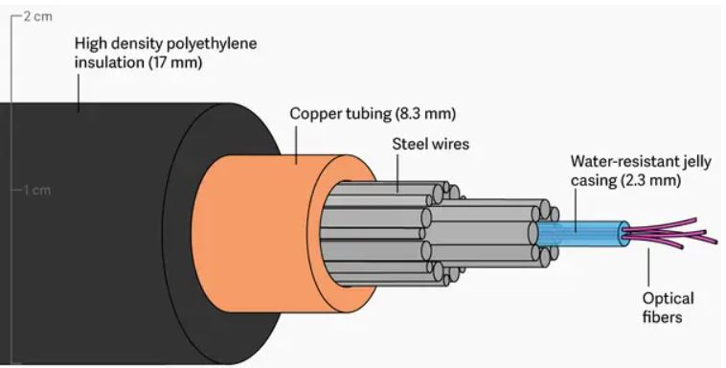
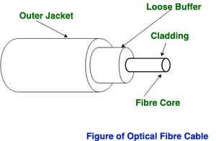
Guided Transmission Media

Slide 69
Wireless Transmission Media
2. Unguided Media:
It is also referred to as Wireless or Unbounded transmission media. No physical medium is required for the transmission of electromagnetic signals.
Features:
The signal is broadcasted through air
Less Secure
Used for larger distances

Slide 70
Wireless Transmission Media
Wireless Communication
Wireless communication is also referred to as Unguided Media or Unbounded transmission media. In this mode, no physical medium is required for the transmission of electromagnetic signals.
In wireless communication, we can transfer our message through the air, water or vacuum i.e. Infrared, Radio wave, Microwave wave. So, we don’t worry about the cables or any material to transfer messages, as we can send out a message without and medium.
Wireless communication has advantages and also have disadvantages like it is less secure if we talk about security.

Slide 71
Wireless Transmission Media
2. Unguided Media:
There are 3 types of Signals transmitted through unguided media:
(i) Radio waves –
These are easy to generate and can penetrate through buildings. The sending and receiving antennas need not be aligned. Frequency Range:3KHz – 1GHz. AM and FM radios and cordless phones use Radio waves for transmission.

Slide 72
Wireless Transmission Media
Uses:
Radio waves are used in AM and FM radios, and cordless phones. Also, some private and government organization reserves certain radio frequencies for direct communication.
Advantage and Disadvantage:
Radio waves have some advantages like they can travel long distances in all directions and can pass through any obstacles, and since they are wireless communication mediums so there is no need of digging and spreading wires. But, yes radio waves have some disadvantages too like radio waves are not effective in bad weather conditions, and they are less secure as they can travel large distances.

Slide 73
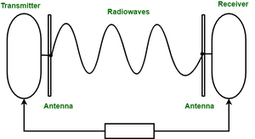
Wireless Transmission Media

Slide 74
Wireless Transmission Media
(ii) Microwaves –
It is a line of sight transmission i.e. the sending and receiving antennas need to be properly aligned with each other.
The distance covered by the signal is directly proportional to the height of the antenna. Frequency Range:1GHz – 300GHz.
These are majorly used for mobile phone communication and television distribution.

Slide 75
Wireless Transmission Media
Uses:
Microwaves are used in mobile phones communication and television distribution.
Advantage and Disadvantage:
If we talk about the advantages of microwaves then we say that it is a very fast way of communication, that can carry 25000 voice channels at the same time. Also, it is a wireless communication medium so there is no need of digging and spreading wires.
Now demerits of microwaves are the first expense, their installation and maintenance are very expensive. that turns this into a very expensive mode of communication. Moreover, Microwaves are also not very effective in bad weather conditions.

Slide 76
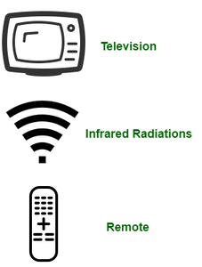
Wireless Transmission Media
(iii) Infrared –
Infrared waves are used for very short distance communication. They cannot penetrate through obstacles. This prevents interference between systems. Frequency Range:300GHz – 400THz. It is used in TV remotes, wireless mouse, keyboard, printer, etc.

Slide 77
Wireless Transmission Media
Uses:
As we have already have discussed they are used in TV remotes, Pc devices like mice, and keyboards.
Advantage and Disadvantage:
If we talk about the merit part of infrared then we can say Infrared is one of the secure wireless communication mediums as it is used for short-range. Also, unlike other wireless mediums, infrared is quite inexpensive, and this is some reason it is used in many electronic devices.
Now, let’s talk about the disadvantaged part of Infrared waves so they can only be used in short-range communication. Also, they cannot penetrate any obstacles like walls or any building.

Slide 78
Wireless Transmission Media
S.no | Infrared | Radio Waves | Microwaves
1 | Infrared is used for short-range communication like TV remotes, mobile phones, personal computers, etc. In science, the Infrared is part of a spectrum that is not visible to the human eye | Radio waves are the type of wireless communication that can travel large distances as well as can penetrate any wall | Microwaves are a line of sight transmission, meaning both the antennas sending and receiving should be properly aligned.
2 | The frequency range of infrared rays 300GHz – 400THz | The frequency range of radio waves:3KHz – 1GHz. | Microwaves have a frequency Range between 1GHz – 300GHz.
3 | The limitation of infrared rays is that they cannot penetrate any obstacles and can only use for short-range. Also, Infrared is used in night vision cameras as it has thermal properties. The frequency range of infrared rays 300GHz – 400THz | It can travel large distances as well as can penetrate any wall ( Omni-directional, | They are unidirectional, as they can move in only one direction, and therefore it is used in point-to-point communication or unicast communication such as radar and satellite.

Slide 79
Wireless Transmission Media
S.no | Infrared | Radio Waves | Microwaves
4 | Infrared is one of the secure wireless communication mediums as it is used for short-range. Also, unlike other wireless mediums, infrared is quite inexpensive, and this is some reason it is used in many electronic devices. | Radio waves can travel to long distances so it is used for long distance communication and there is no need of digging and spreading wires. | Advantages of microwaves then we say that it is a very fast way of communication, that can carry 25000 voice channels at the same time. Also, it is a wireless communication medium so there is no need of digging and spreading wires.
5 | Infrared waves are used in TV remotes, mobile phones, personal computers | Radio waves are used in AM and FM radios, and cordless phones. | Microwaves are used in mobile phones communication and television distribution.

Slide 80
Line of Sight Transmission
Line of sight (LoS) is a type of propagation that can transmit and receive data only where transmit and receive stations are in view of each other without any sort of an obstacle between them.
FM radio, microwave and satellite transmission are examples of line-of-sight communication.
Long-distance data communication is more effective through wireless networks but geographical obstacles and the curvature of the earth bring limitations to line-of-sight transmission. However, these issues can generally be mitigated through planning, calculations and the use of additional technologies.

Slide 81
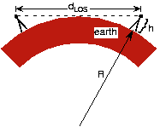
Line of Sight Transmission
For example, mobile phones use a modified line-of-sight transmission, which is made possible through a combination of effects like diffraction, multipath reflection, local repeaters and rapid handoff.

Slide 82
Concept of circuit, Message, Packet Switching with their timing diagram
In large networks, there can be multiple paths from sender to receiver. The switching technique will decide the best route for data transmission.
Switching technique is used to connect the systems for making one-to-one communication.

Slide 83
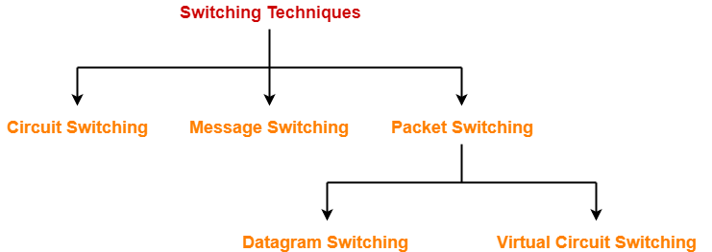
Concept of circuit, Message, Packet Switching with their timing diagram

Slide 84
Concept of circuit, Message, Packet Switching with their timing diagram
Circuit Switching
Circuit switching is a switching technique that establishes a dedicated path between sender and receiver.
In the Circuit Switching Technique, once the connection is established then the dedicated path will remain to exist until the connection is terminated.
Circuit switching in a network operates in a similar way as the telephone works.
A complete end-to-end path must exist before the communication takes place.

Slide 85
Concept of circuit, Message, Packet Switching with their timing diagram
Circuit Switching
In case of circuit switching technique, when any user wants to send the data, voice, video, a request signal is sent to the receiver then the receiver sends back the acknowledgment to ensure the availability of the dedicated path.
After receiving the acknowledgment, dedicated path transfers the data.
Circuit switching is used in public telephone network. It is used for voice transmission.
Fixed data can be transferred at a time in circuit switching technology.

Slide 86
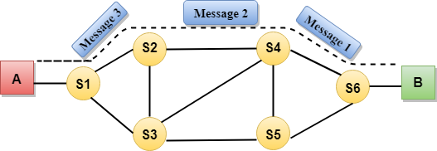
Concept of circuit, Message, Packet Switching with their timing diagram
Communication through circuit switching has 3 phases:
Circuit establishment
Data transfer
Circuit Disconnect

Slide 87
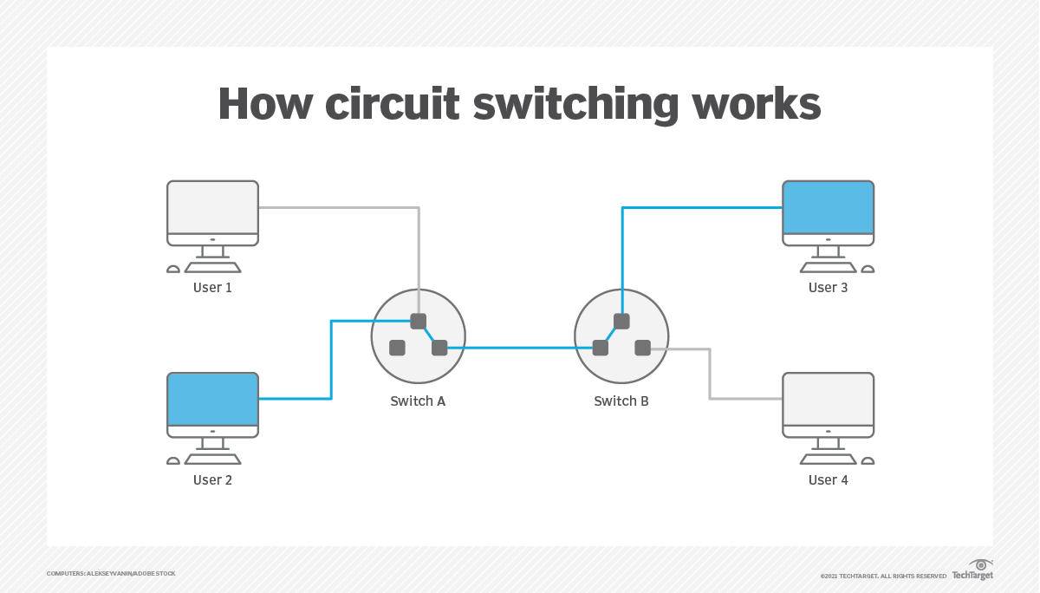
Concept of circuit, Message, Packet Switching with their timing diagram

Slide 88
Concept of circuit, Message, Packet Switching with their timing diagram
Circuit Switching
In case of circuit switching technique, when any user wants to send the data, voice, video, a request signal is sent to the receiver then the receiver sends back the acknowledgment to ensure the availability of the dedicated path.
After receiving the acknowledgment, dedicated path transfers the data.
Circuit switching is used in public telephone network. It is used for voice transmission.
Fixed data can be transferred at a time in circuit switching technology.

Slide 89
Concept of circuit, Message, Packet Switching with their timing diagram
Space Division Switches:
Space Division Switching is a circuit switching technology in which a single transmission path is accomplished in a switch by using a physically separate set of crosspoints.
Space Division Switching can be achieved by using crossbar switch. A crossbar switch is a metallic crosspoint or semiconductor gate that can be enabled or disabled by a control unit.
Space Division Switching has high speed, high capacity, and nonblocking switches.

Slide 90
Concept of circuit, Message, Packet Switching with their timing diagram
Advantages Of Circuit Switching:
In the case of Circuit Switching technique, the communication channel is dedicated.
It has fixed bandwidth.

Slide 91
Concept of circuit, Message, Packet Switching with their timing diagram
Disadvantages Of Circuit Switching:
Once the dedicated path is established, the only delay occurs in the speed of data transmission.
It takes a long time to establish a connection approx 10 seconds during which no data can be transmitted.
It is more expensive than other switching techniques as a dedicated path is required for each connection.
It is inefficient to use because once the path is established and no data is transferred, then the capacity of the path is wasted.
In this case, the connection is dedicated therefore no other data can be transferred even if the channel is free.

Slide 92
Concept of circuit, Message, Packet Switching with their timing diagram
Telephone system network is one of the example of Circuit switching. TDM (Time Division Multiplexing) and FDM (Frequency Division Multiplexing) are two methods of multiplexing multiple signals into a single carrier.
Frequency Division Multiplexing : Divides into multiple bands
Frequency Division Multiplexing or FDM is used when multiple data signals are combined for simultaneous transmission via a shared communication medium.
It is a technique by which the total bandwidth is divided into a series of non-overlapping frequency sub-bands, where each sub-band carry different signal. Practical use in radio spectrum & optical fibre to share multiple independent signals.

Slide 93
Concept of circuit, Message, Packet Switching with their timing diagram
Time Division Multiplexing : Divides into frames
Time-division multiplexing (TDM) is a method of transmitting and receiving independent signals over a common signal path by means of synchronized switches at each end of the transmission line.
TDM is used for long-distance communication links and bears heavy data traffic loads from end user.
Time division multiplexing (TDM) is also known as a digital circuit switched.

Slide 94
Concept of circuit, Message, Packet Switching with their timing diagram
Message Switching
Message Switching is a switching technique in which a message is transferred as a complete unit and routed through intermediate nodes at which it is stored and forwarded.
In Message Switching technique, there is no establishment of a dedicated path between the sender and receiver.
The destination address is appended to the message. Message Switching provides a dynamic routing as the message is routed through the intermediate nodes based on the information available in the message.

Slide 95
Concept of circuit, Message, Packet Switching with their timing diagram
Message Switching
Message switches are programmed in such a way so that they can provide the most efficient routes.
Each and every node stores the entire message and then forward it to the next node. This type of network is known as store and forward network.
Message switching treats each message as an independent entity.

Slide 96
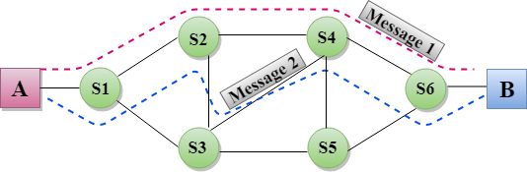
Concept of circuit, Message, Packet Switching with their timing diagram

Slide 97
Concept of circuit, Message, Packet Switching with their timing diagram
Packet Switching
The packet switching is a switching technique in which the message is sent in one go, but it is divided into smaller pieces, and they are sent individually.
The message splits into smaller pieces known as packets and packets are given a unique number to identify their order at the receiving end.
Every packet contains some information in its headers such as source address, destination address and sequence number.

Slide 98
Concept of circuit, Message, Packet Switching with their timing diagram
Packet Switching
Packets will travel across the network, taking the shortest path as possible.
All the packets are reassembled at the receiving end in correct order.
If any packet is missing or corrupted, then the message will be sent to resend the message.
If the correct order of the packets is reached, then the acknowledgment message will be sent.

Slide 99
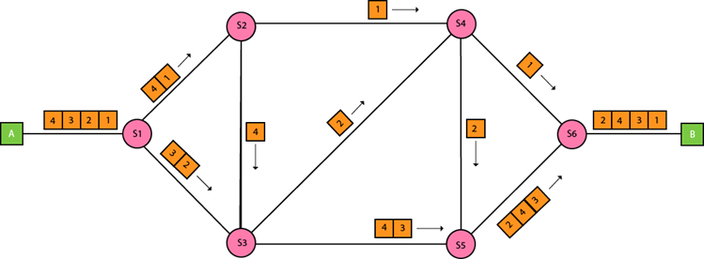
Concept of circuit, Message, Packet Switching with their timing diagram

Slide 100
Concept of circuit, Message, Packet Switching with their timing diagram
Approaches Of Packet Switching:
There are two approaches to Packet Switching:
Datagram Packet switching:
It is a packet switching technology in which packet is known as a datagram, is considered as an independent entity. Each packet contains the information about the destination and switch uses this information to forward the packet to the correct destination.
The packets are reassembled at the receiving end in correct order.
In Datagram Packet Switching technique, the path is not fixed.
Intermediate nodes take the routing decisions to forward the packets.
Datagram Packet Switching is also known as connectionless switching.

Slide 101
Concept of circuit, Message, Packet Switching with their timing diagram
Approaches Of Packet Switching:
Virtual Circuit Switching
Virtual Circuit Switching is also known as connection-oriented switching.
In the case of Virtual circuit switching, a preplanned route is established before the messages are sent.
Call request and call accept packets are used to establish the connection between sender and receiver.
In this case, the path is fixed for the duration of a logical connection.

Slide 102
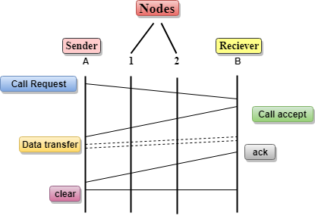
Concept of circuit, Message, Packet Switching with their timing diagram
Let's understand the concept of virtual circuit switching through a diagram:

Slide 103
Concept of circuit, Message, Packet Switching with their timing diagram
In the above diagram, A and B are the sender and receiver respectively. 1 and 2 are the nodes.
Call request and call accept packets are used to establish a connection between the sender and receiver.
When a route is established, data will be transferred.
After transmission of data, an acknowledgment signal is sent by the receiver that the message has been received.
If the user wants to terminate the connection, a clear signal is sent for the termination.

Slide 104
Concept of circuit, Message, Packet Switching with their timing diagram
Advantages Of Packet Switching:
Cost-effective: In packet switching technique, switching devices do not require massive secondary storage to store the packets, so cost is minimized to some extent. Therefore, we can say that the packet switching technique is a cost-effective technique.
Reliable: If any node is busy, then the packets can be rerouted. This ensures that the Packet Switching technique provides reliable communication.
Efficient: Packet Switching is an efficient technique. It does not require any established path prior to the transmission, and many users can use the same communication channel simultaneously, hence makes use of available bandwidth very efficiently.

Slide 105
Concept of circuit, Message, Packet Switching with their timing diagram
Disadvantages Of Packet Switching:
Packet Switching technique cannot be implemented in those applications that require low delay and high-quality services.
The protocols used in a packet switching technique are very complex and requires high implementation cost.
If the network is overloaded or corrupted, then it requires retransmission of lost packets. It can also lead to the loss of critical information if errors are nor recovered.

Slide 106
Concept of circuit, Message, Packet Switching with their timing diagram
S.NO | Circuit Switching | Message Switching
1. | Circuit Switching is done by setting a physical path between two systems. | In message Switching, data is first stored by one node then forward to another node to transfer the data to another system.
2. | In circuit switching, data is not stored. | In message Switching, data is first stored, then forwarded to the next node.
3. | Circuit Switching needs a dedicated physical path that’s why the messages need not be addressed. | Message switching does not need a dedicated physical path and on Message switching, The messages are addressed independently.
4. | Circuit Switching is Geographical addressing. | Message Switching is Hierarchical addressing.
5. | Circuit Switching is costlier than message Switching. | The cost of message switching is less than circuit switching.
6. | Circuit switching routing is manual type routing. | Message Switching routing is not manual type routing, here route is selected during call setup.

Slide 107
Concept of circuit, Message, Packet Switching with their timing diagram
S.NO | Circuit Switching | Message Switching
7. | Circuit switching reserves the full bandwidth in advance. because of that, there is a lot of wastage of bandwidth | Message Switching does not reserve the entire bandwidth in advance. and that’s why bandwidth is used to its maximum extent.
8. | In-circuit switching, the charge depends on time and distance. | In message switching, the charge is based on the number of bytes and distance.
9. | Congestion occurs per minute in circuit switching. | In message switching, no congestion or very little congestion occurs.
10. | Circuit switching uses Analog and digital media on a variety of platforms. | Whereas Message switching uses digital media on a variety of platforms.
11. | In-circuit switching there is no propagation delay. | While In Message switching there is a propagation delay.
12. | The transmission capacity of circuit switching is very low. | while the transmission capacity of message switching is high.
13. | In a circuit switching, Messages need not be addressed as there is one dedicated path. | In message switching, Messages are addressed as independent routes are established.
14. | Ex. Real time transfer of voice signals. | Ex. Transmission of telegram.

Slide 108
Concept of circuit, Message, Packet Switching with their timing diagram
Basics | Circuit Switching | Message Switching | Packet Switching
Connection Creation | Connection is created between the source and destination by establishing a dedicated path between source and destination. | Links are created independently one by one between the nodes on the way. | Links are created independently one by one between the nodes on the way.
Queuing | No queue is formed. | Queue is formed. | Queue is formed.
Message and Packets | There is one big entire data stream called a message. | There is one big entire data stream called a message. | The big message is divided into a small number of packets.
Routing | One single dedicated path exists between the source and destination. | Messages follow the independent route to reach a destination. | Packets follow the independent path to hold the destination.
Addressing and sequencing | Messages need not be addressed as there is one dedicated path. | Messages are addressed as independent routes are established. | Packets are addressed, and sequencing is done as all the packets follow the independent route.

Slide 109
Concept of circuit, Message, Packet Switching with their timing diagram
Basics | Circuit Switching | Message Switching | Packet Switching
Propagation Delay | No | Yes | Yes
Transmission Capacity | Low | Maximum | Maximum
Sequence Order | Message arrives in Sequence. | Message arrives in Sequence. | Packets do not appear in sequence at the destination.
Use Bandwidth | Wastage | Bandwidth is used to its maximum extent. | Bandwidth is used to its maximum extent.

Slide 110
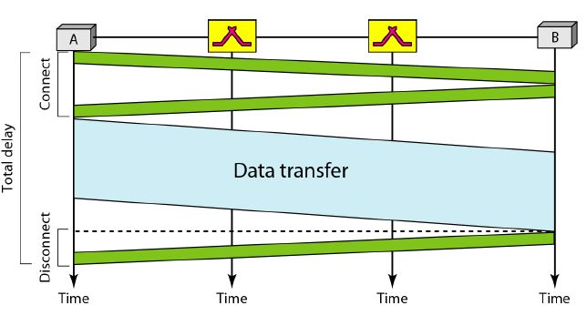
Concept of circuit, Message, Packet Switching with their timing diagram

Slide 111
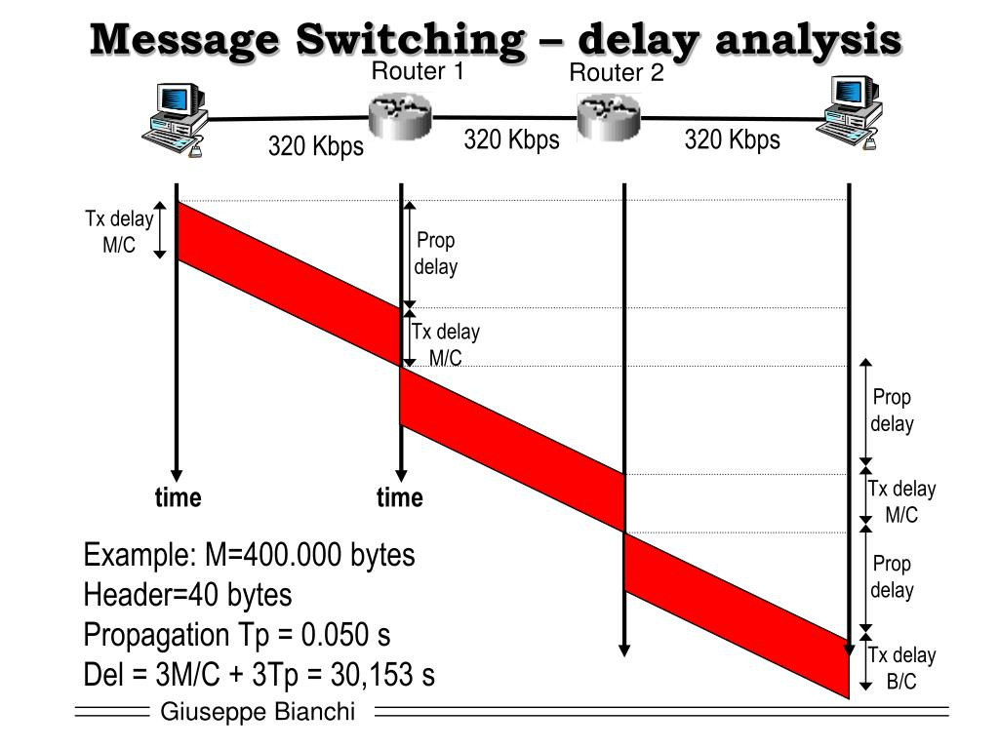
Concept of circuit, Message, Packet Switching with their timing diagram

Slide 112
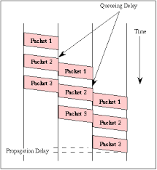
Concept of circuit, Message, Packet Switching with their timing diagram

Slide 113
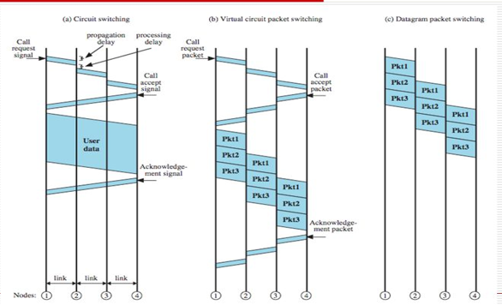
Concept of circuit, Message, Packet Switching with their timing diagram

